Slide 1


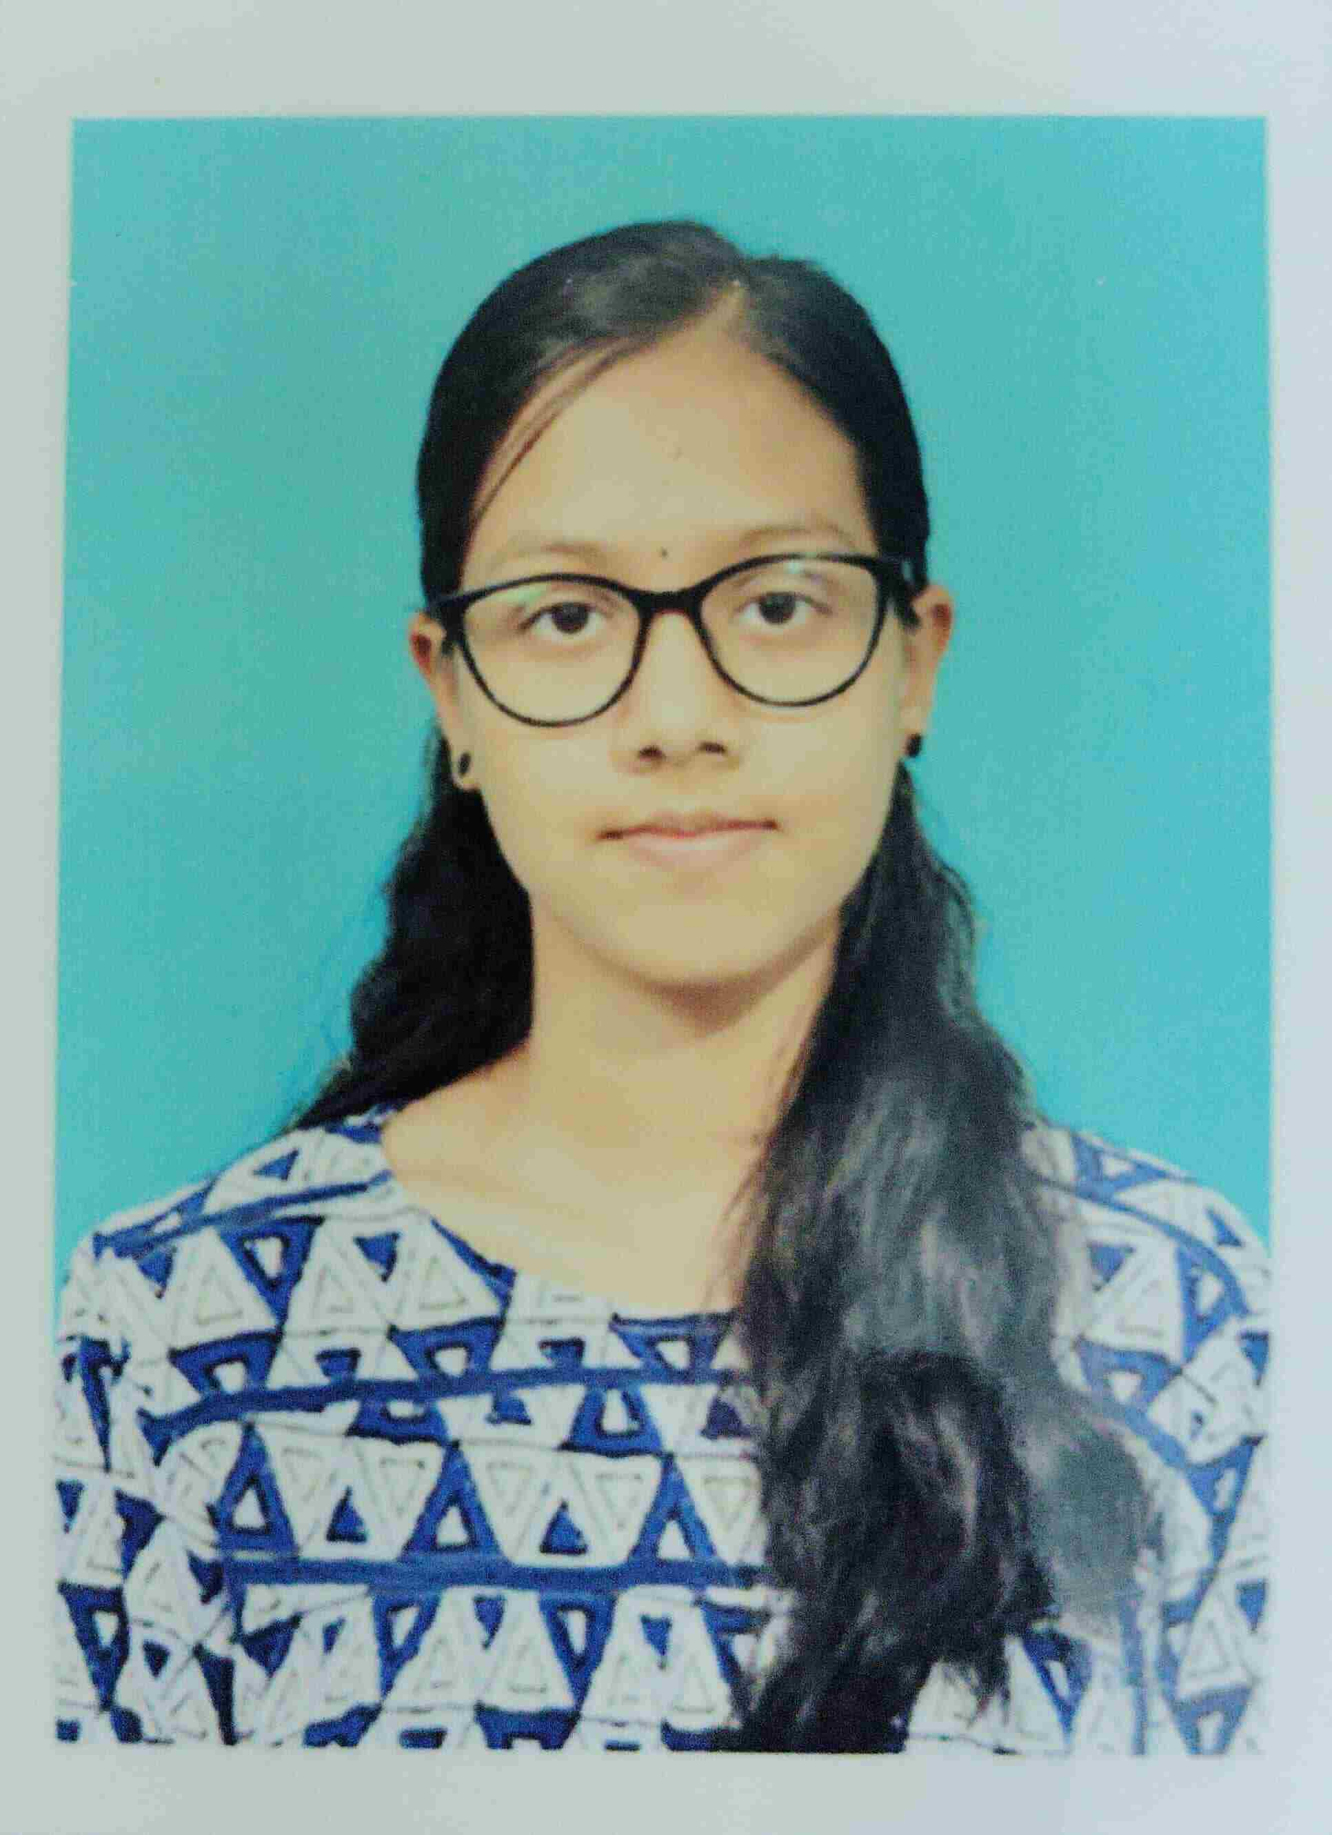

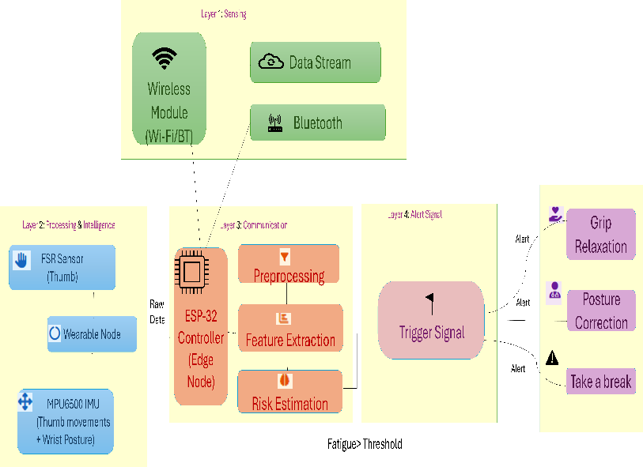
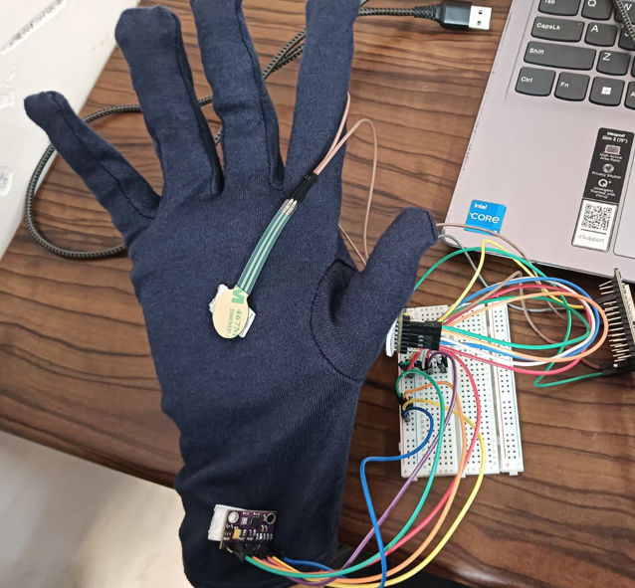
Wearable IOT System for Real-Time Hand Fatigue Detection
using MPU6500 sensor during smartphone use
Dr.S.Pavithra Dhanya S – 23MIA1010 Hemila Saravanan – 23MIA1048
Vellore Institute of Technology Chennai, India, School of Computer Science and Engineering
MOTIVATION / INTRODUCTION
Raising the Smartphone User-base and Health Impact: The continued use of smartphones in the digital age has become an inevitable aspect of life. Repeated use of smartphones by scrolling and texting on them, and holding them, are very likely to expose people to musculoskeletal disorders, hand fatigue, tendon inflammation, and the initial signs of carpal tunnel syndrome.
Weaknesses of Traditional Fatigue Detection Methods: The conventional ways of detecting fatigue are based on the use of laboratory-based devices that include motion capture and electromyography (EMG) which have a high cost, are complex and cannot be used in real time in monitoring fatigue.
Wearable IoT and Multi-Sensor Fusion: The suggested system consists of the integration of Force Sensitive Resistor (FSR) and dual MPU6500 IMU sensors with ESP32 microcontroller to track the grip force, thumb motion, and the wrist position.
OBJECTIVES
Design an IoT-based wearable that can detect hand fatigue in real time when using a smartphone over long periods of time.
• Perform multi- sensor fusion with FSR sensors and dual MPU6500 IMU sensors to measure grip force, thumb movement as well as wrist posture.
Design a fast fatigue estimation algorithm to estimate the fatigue score based on grip force, motion variability and the time of use.
• To ensure that fatigue levels are not allowed to reach certain pre-determined levels, install real-time alert systems through the use of Telegram notifications to alert users.
• Promote ergonomic smartphone usage habits and prevent long-term musculoskeletal disorders.
SCOPE OF THE PROJECT
This project requires the design of a wearable IoT-enabled glove that can be used to monitor the fatigue of the hands in real-time when using a smartphone. Grip force, wrist posture, and thumb motion are measured by embedded sensors, and the data is processed locally with an ESP32 microcontroller in the system. An algorithm of fatigue estimation assesses sustained grip, repetitive movement of the thumb, variability of the wrist, and usage duration to calculate a fatigue score. Telegram notifications are used to send real-time alerts to motivate people to use the app healthier. The system offers a low-priced, wearable, and scalable system to detect early fatigue. It can be applied to the gaming, workplace ergonomics, rehabilitation monitoring, and smart wearable healthcare applications.
METHODOLOGY
Preprocessing
The sensor data of the FSR and dual MPU6500 sensors are then processed in order to eliminate noise and irregular variations. exponential low-pass filtering method is used to smooth sudden spikes due to hand vibrations and distortions of the environment. The data which is filtered is then normalized to give consistent ranges of measurements. Among them, grip force, variability in thumb movement, variation in the position of the wrist, and cumulative time of use are extracted as key features. This preprocessing task increases the reliability of signal and the accuracy in detecting fatigue during real time monitoring conditions.
ARCHITECTURE
Fig 1 Proposed System architecture to detect hand fatigue during smartphone use
Fig 2. Wearable prototype with FSR and IMU sensors used for smartphone hand fatigue monitoring
The suggested system consists of sensing and processing modules fitted in a wearable glove. FSR sensor is a sensor that measures the grip force and two MPU6500 sensors detect the thumb motion and posture of the wrist. ESP32 microcontroller then calculates a fatigue score out of the extracted features using a rule-based fatigue estimation algorithm . Telegram notifications are also delivered when the fatigue surpasses some set limit.
RESULTS
CONCLUSION
This paper presents a wearable IoT hand fatigue detector system, which was created with Force Sensitive Resistor (FSR) and two MPU6500 sensors and paired with an ESP32 microcontroller. The various measures of performance include responsiveness, fatigue detection accuracy and the ability to give real-time alert and hence effective and reliable fatigue monitoring. Multi-sensor fusion improves detection accuracy, while Telegram alerts provide timely feedback to users. The low-cost solution promotes healthier smartphone usage habits and can be extended to gaming, workplace ergonomics, rehabilitation, and wearable healthcare applications for proactive fatigue management.
CONTACT DETAILS
MAIL ID: dhanya.s2023@vitstudent.ac.in
MOBILE NO: +91 9445964855
MAIL ID: hemila.saravanan2023@vitstudent.ac.in
MOBILE NO: +91 9677235962
REFERENCES
[1] Matteo Musso, Shaoping Bai, Anderson Souza Oliveira, Using a wearable system combining inertial and force sensing for simultaneous detection of limb motion and grasping actions in the workplace, Sensors, 25 (2025). https://doi.org/10.1017/wtc.2025.10026
Sensor | Parameter Measured | Converted Sensor Range | Threshold Condition | Fatigue Score Weightage
FSR (Force sensitive resistor) | Grip force | 0 – 4095 (ESP32 ADC) | Grip > 200 ADC | +30
Thumb MPU6500 | Thumb motion variation | 0 to +250°/s | ThumbVar > 20°/s | +30
Wrist MPU6500 | Wrist motion variation | 0 to +250°/s | WristVar < 2°/s | +20

